Slide 1
DATA COMPRESSION AND DECOMPRESSION USING
HUFFMANN CODING ALGORITHM
Mentor : Dr. Suyash Bhardawaj

Slide 2
Why Data Compression?
Text files can be compressed to make them smaller and faster to send, and unzipping files on devices has a low overhead.
We use the Huffman Coding algorithm for this purpose which is a greedy algorithm that assigns variable length binary codes for each input character in the text file. The length of the binary code depends on the frequency of the character in the file.

Slide 3
How Does The Process Of Compression Work?
The size of the text file can be reduced by compressing it, which converts the text to a smaller format that takes up less space. It typically works by locating similar strings/characters within a text file and replacing them with a temporary binary representation to reduce the overall file size.

Slide 4


Tech Stack Used:
C++
React
Node Js
CSS

Slide 5
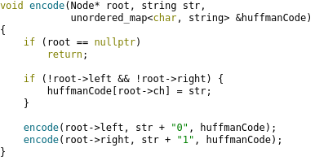
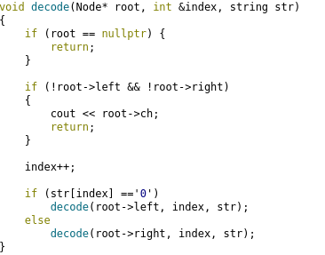
Cpp Implemetation Snapshots :

Slide 6
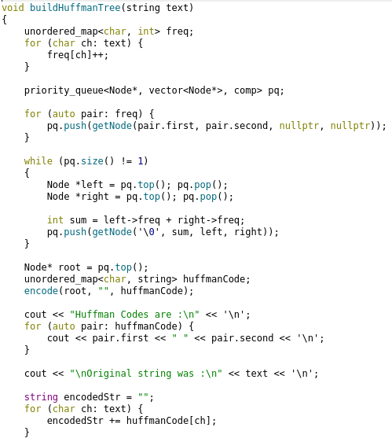
Cpp Implementation Snapshots:

Slide 7
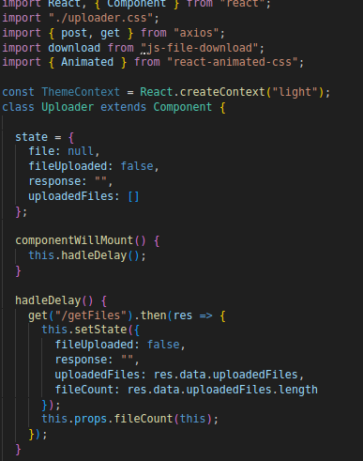
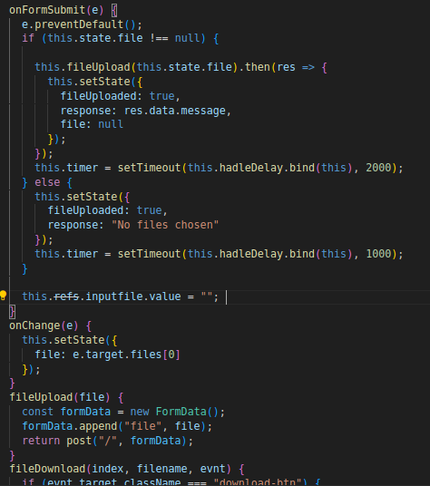
Frontend Code Snapshots :

Slide 8

Frontend Snapshots :

Slide 9
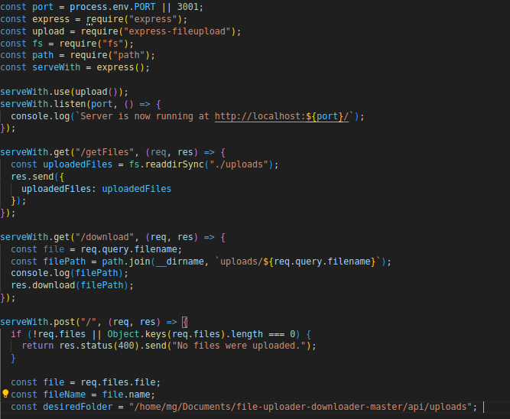
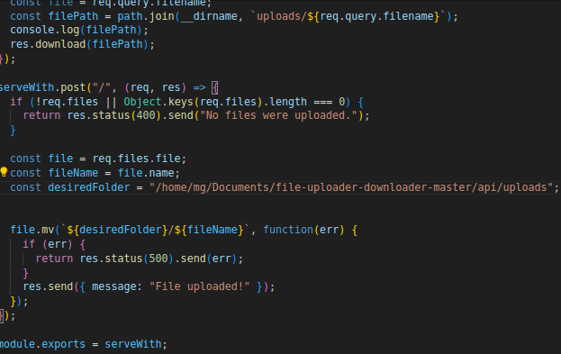
Backend Code Snapshots :

Slide 10
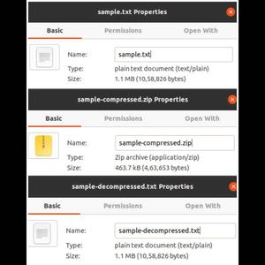
Results :
We can achieve a compression
rate of nearly 50 percent.
When there will be a large
amout of files then the algo
will be very beneficial.

